Slide 1

Introduction to the N-Queen Problem
The N-Queen problem is a classic puzzle in computer science. The goal is to place N chess queens on an N×N chessboard so that no two queens threaten each other. This means no two queens can share the same row, column, or diagonal.

Slide 2

Explanation of the N-Queen Problem
The N-Queen problem is a constraint satisfaction problem. It involves finding a configuration that satisfies all the constraints. The constraints are the rules of chess, which dictate how queens can move. The solution involves finding a placement of queens that satisfies all the constraints.
1
Chess Constraints
The N-Queen problem is based on the rules of chess. Queens can move horizontally, vertically, and diagonally any number of spaces.
2
Queen Placement
The goal is to find a placement of N queens on an N×N chessboard where no two queens threaten each other.
3
Constraint Satisfaction
The N-Queen problem involves finding a configuration that satisfies all the constraints, which are the rules of chess.

Slide 3
Approach to Solving the N-Queen Problem
The N-Queen problem can be solved using a variety of approaches, including backtracking, brute force, and constraint programming. Backtracking is a common approach. It involves recursively trying different queen placements and backtracking when a conflict is encountered.
1
Initialize
Start with an empty chessboard.
2
Place Queen
Try placing a queen in the first column.
3
Check Conflict
Check if the placement conflicts with any existing queens.
4
Backtrack
If a conflict occurs, backtrack and try a different placement.
5
Repeat
Repeat the process until all queens are placed without conflicts.

Slide 4



Visualization of the N-Queen Problem
Visualizing the N-Queen problem helps to understand the problem and its solutions. Visualizations can show the placement of queens, the threats between queens, and the process of finding a solution.
Threat Lines
Queen Placement Order
Interactive Visualization
Visualize the threats between queens by drawing lines from each queen to all squares it can attack.
Color-code the queens to show the order in which they were placed, highlighting the backtracking process.
Create an interactive visualization that allows users to change the size of the board and see different solutions.

Slide 5
Implementation of the N-Queen Visualizer in C++
The N-Queen visualizer can be implemented in C++ using the windows API. The visualizer displays the chessboard, queens, and the backtracking process in the terminal. The code handles user input to set the board size and visually displays the solution found.
Chessboard
Queens
Visualizer
A 2D array can be used to represent the chessboard.
The position of queens can be stored in an array or vector.
A graphical library can be used to display the chessboard, queens, and the backtracking process.

Slide 6
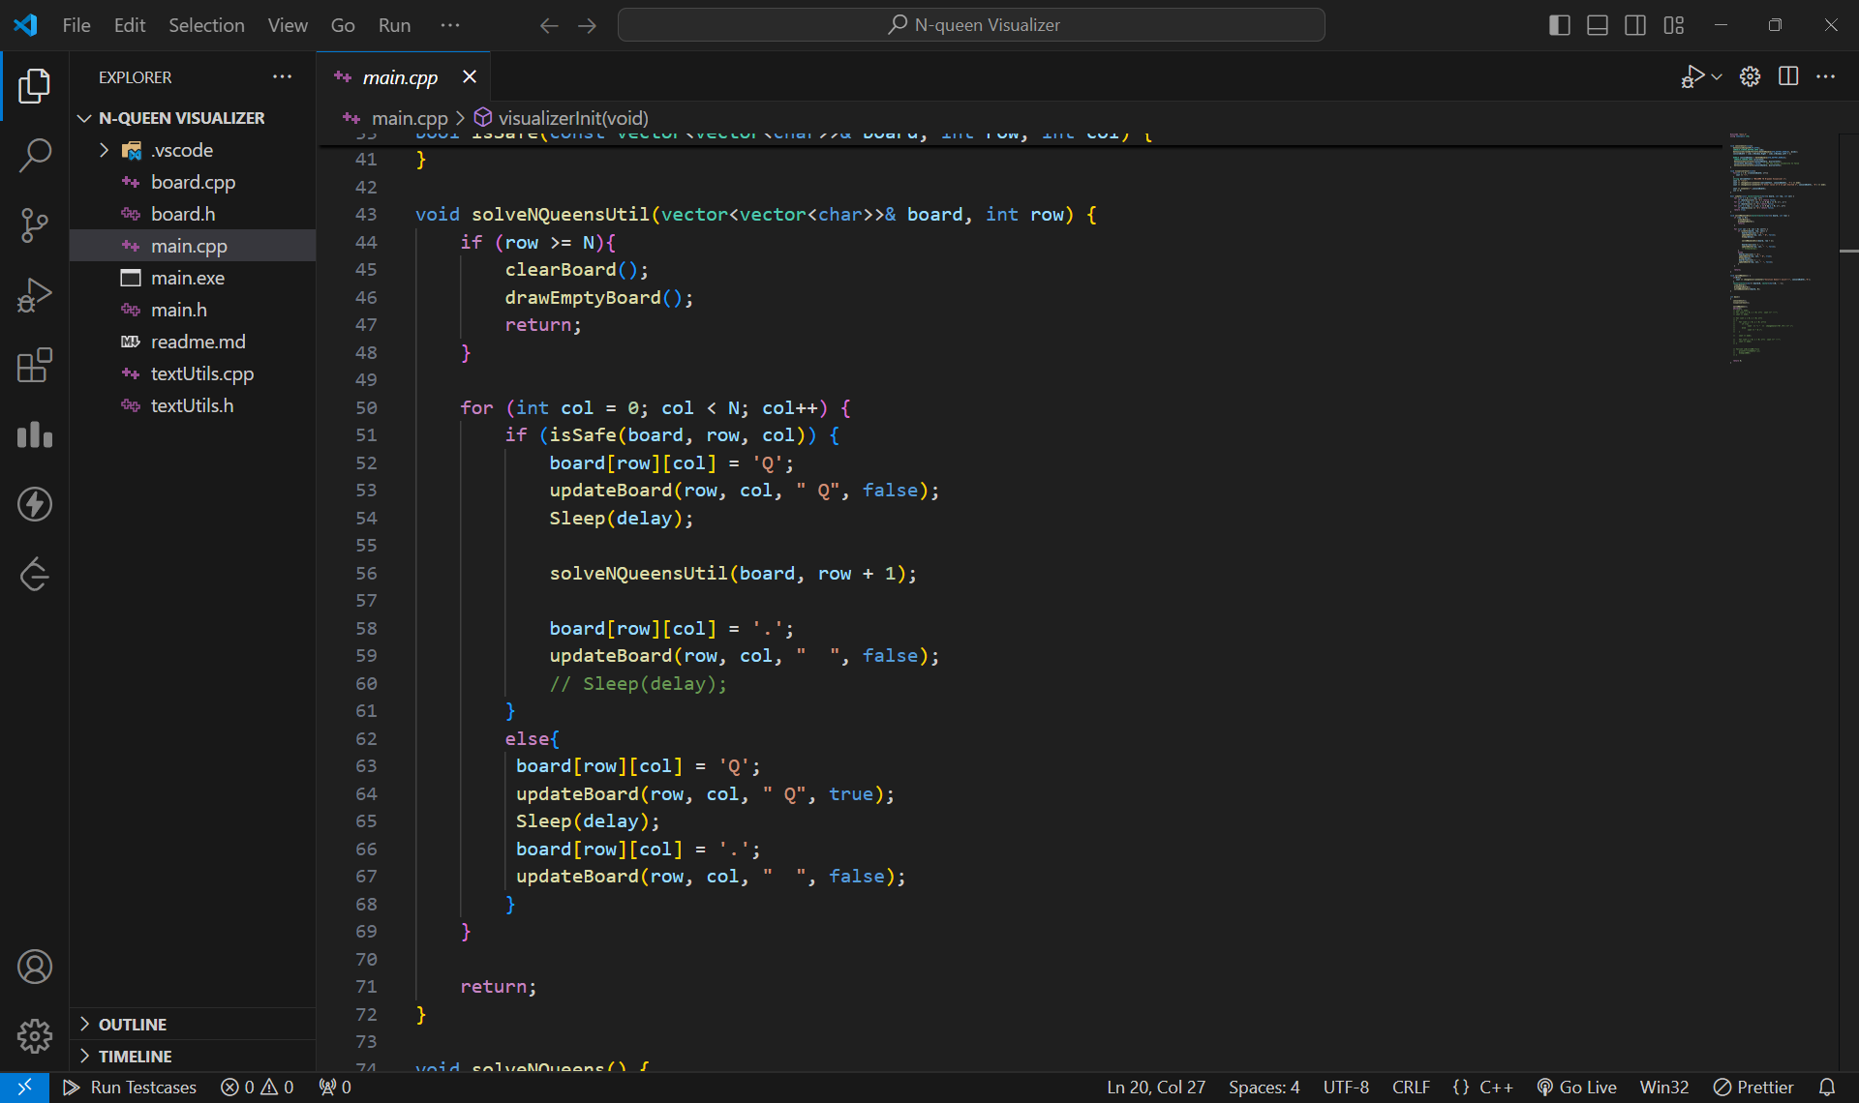
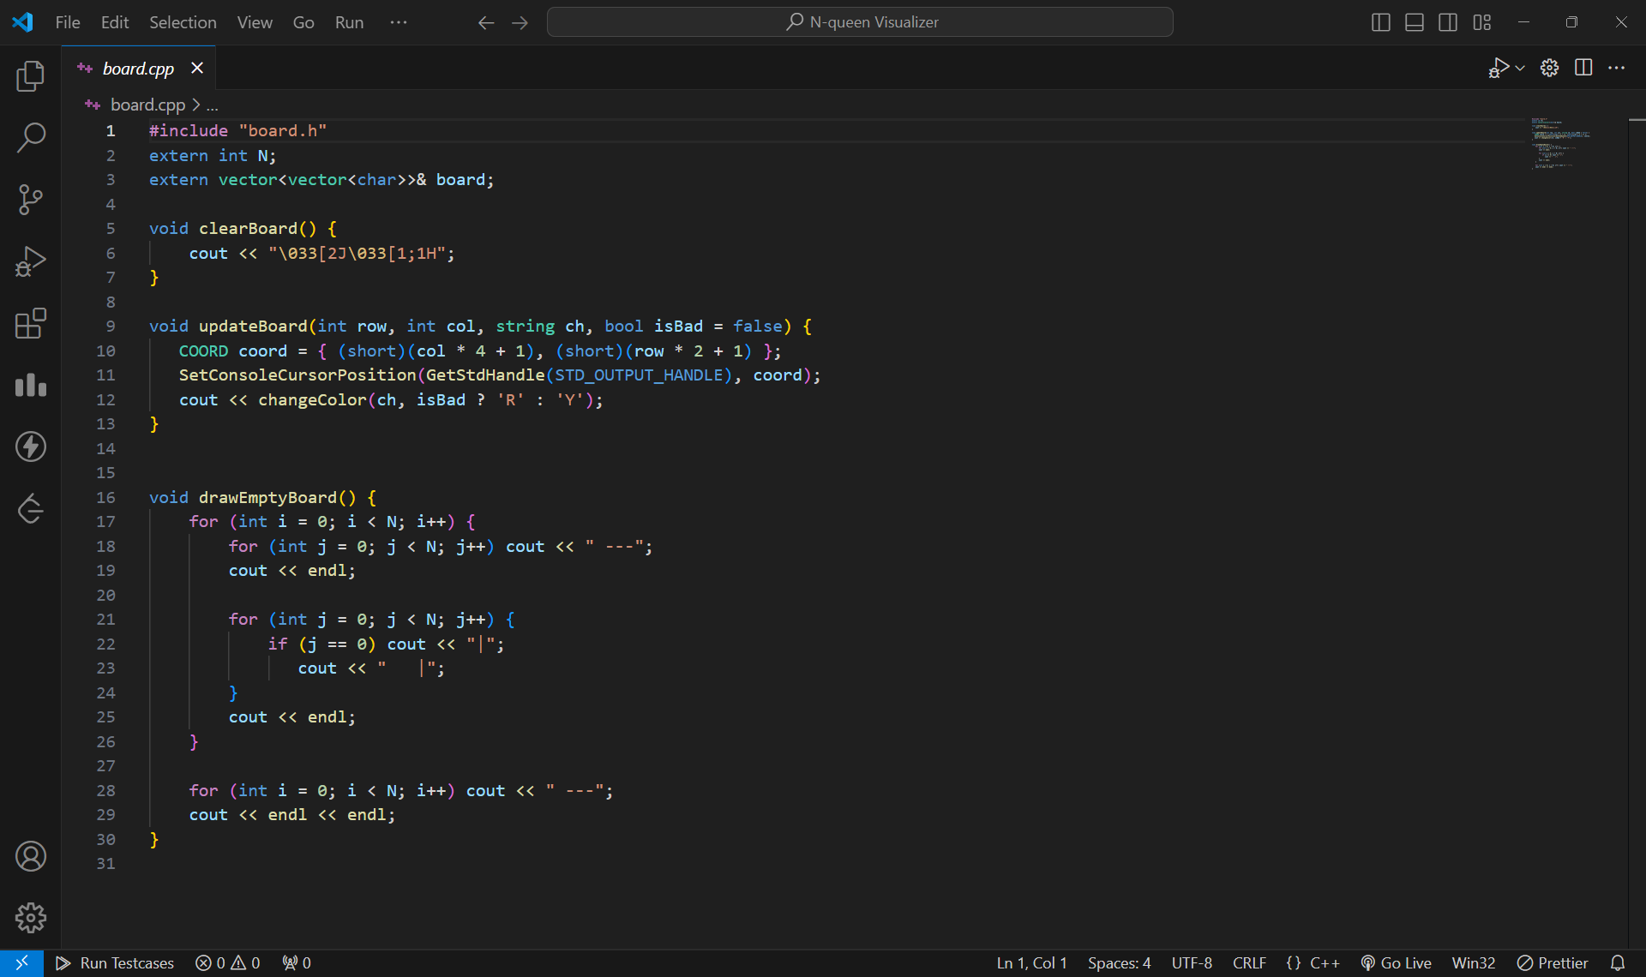
Some code snippets of N-Queen visualizer

Slide 7

Challenges and Considerations in the Implementation
Implementing the N-Queen visualizer presents challenges in handling user input, visual representation of the chessboard and queens, and the efficient backtracking algorithm. The visualizer must be responsive and provide a clear representation of the problem.
User Input
Efficiently handle user input to change the board size or explore different solutions.
Visualization
Create a visually appealing and intuitive representation of the chessboard, queens, and the backtracking process.
Performance
Ensure that the visualizer performs efficiently even for large board sizes.

Slide 8





Demonstration of the N-Queen Visualizer
The N-Queen visualizer can be demonstrated by showcasing its features and capabilities. This includes displaying the chessboard, placing queens, backtracking, and finding solutions. The demonstration should highlight the visual representation and the user interaction.
Start
Begin by selecting the board size.
Place Queens
Place queens on the board, ensuring no conflicts.
Backtrack
Backtrack if a conflict is encountered.
Solve
Display the solution(s) found.

Slide 9




Conclusion and Future Enhancements
The N-Queen problem has been a captivating challenge in computer science, showcasing the power of algorithms. The visualizer developed is a valuable tool for understanding the problem, its solutions, and the efficiency of different approaches.
Future Enhancements
Enhancements could include animations, 3D visualization, and additional solver algorithms.
Command Line Interface
Enhancing the command-line interface could facilitate more effective interaction with the visualizer, making it easier to use and understand.
Customization
Users should be able to customize the visualizer, including board size, queen color, and animation speed.

